Slide 1
Catema start guide for students
https://www.catema.net/rccd/

Slide 2
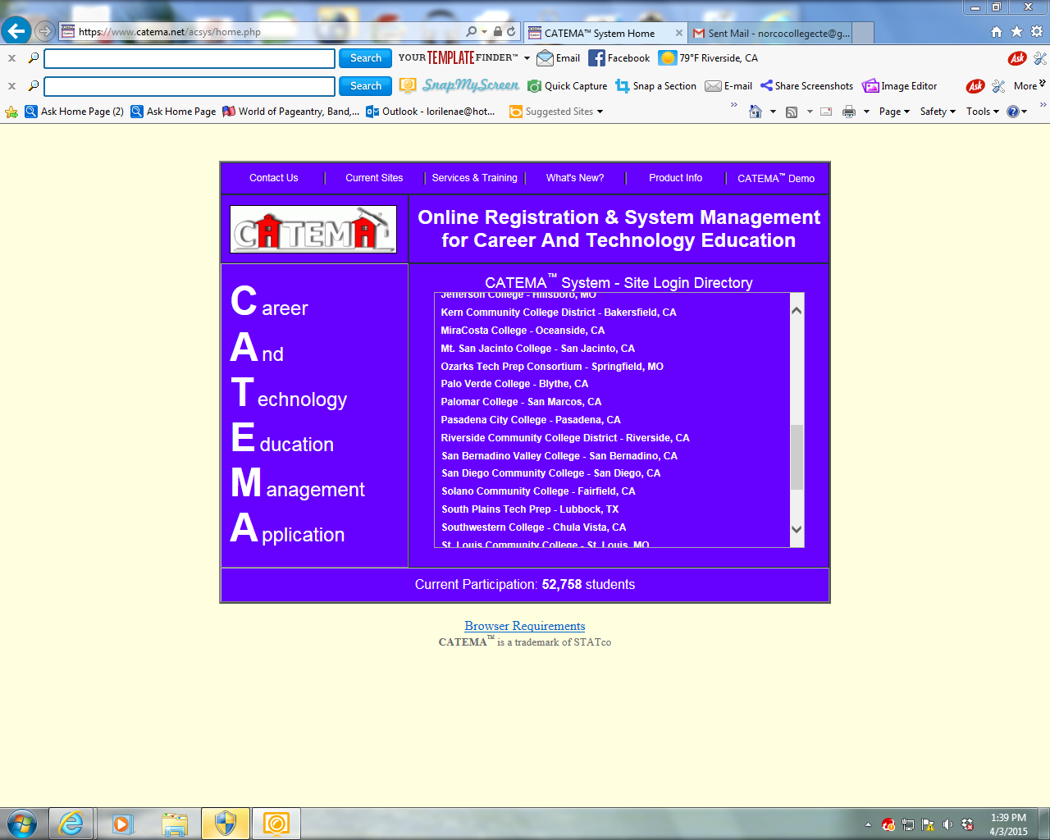
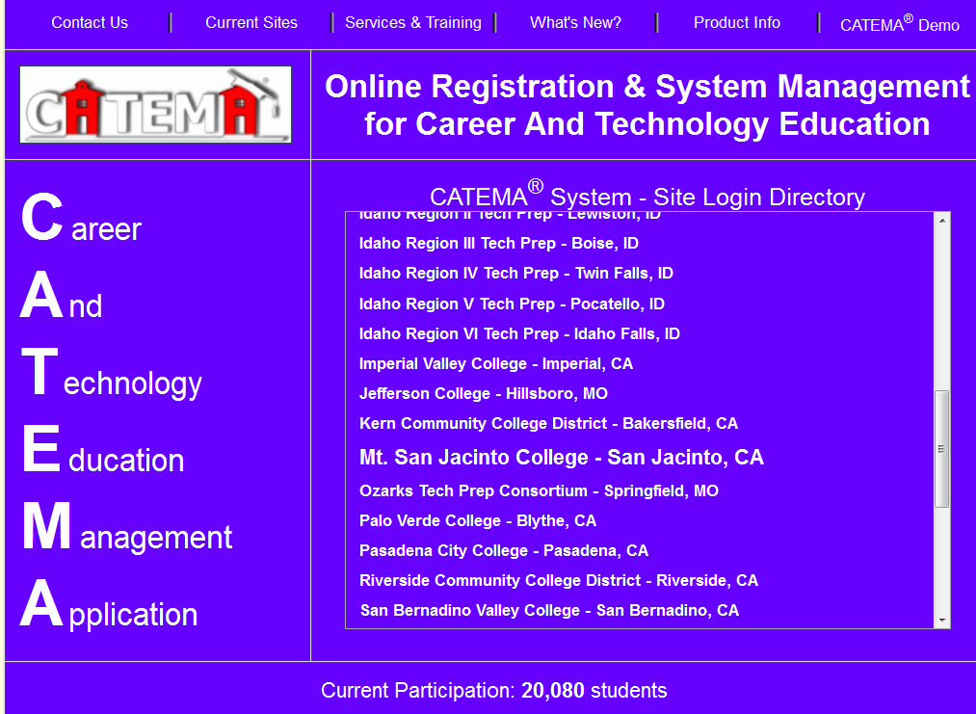
Scroll down until you find RCCD
Scroll down
until you find
RCCD

Slide 3
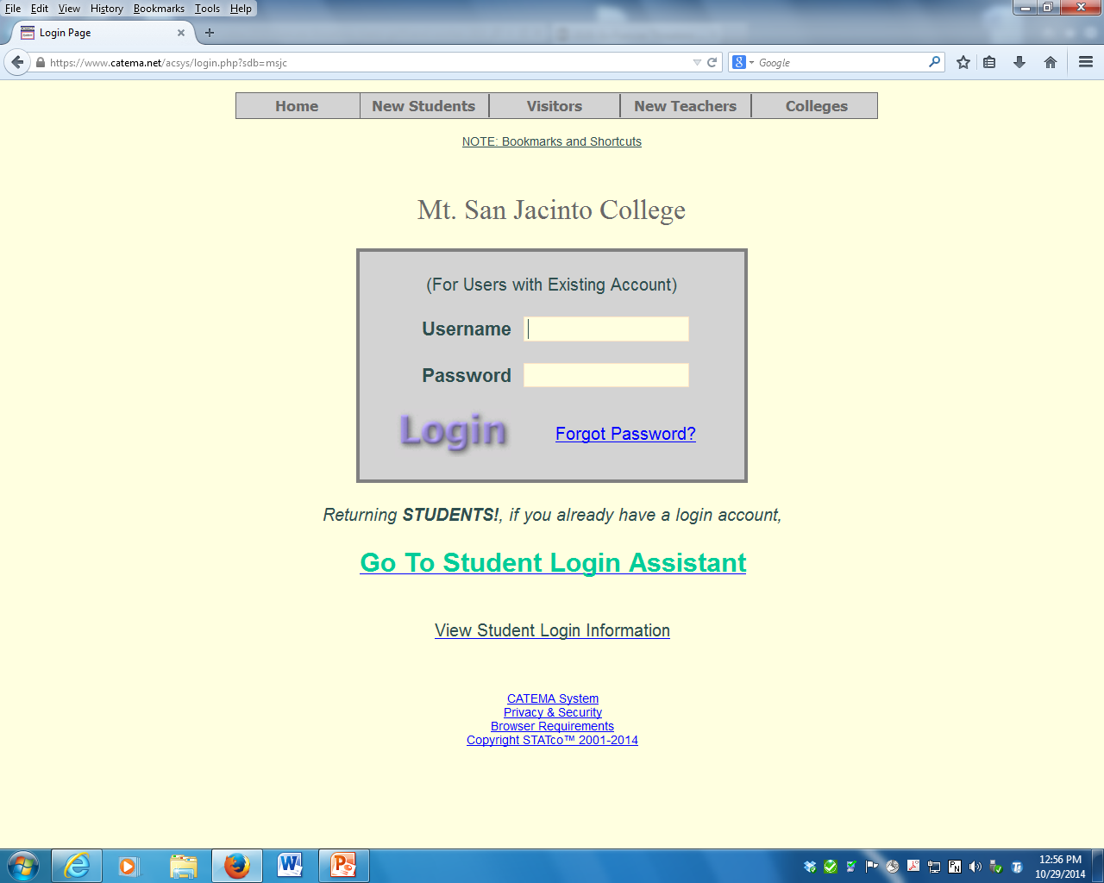
Riverside Community College District
Make sure it has RCCD as the name of the college

Slide 4
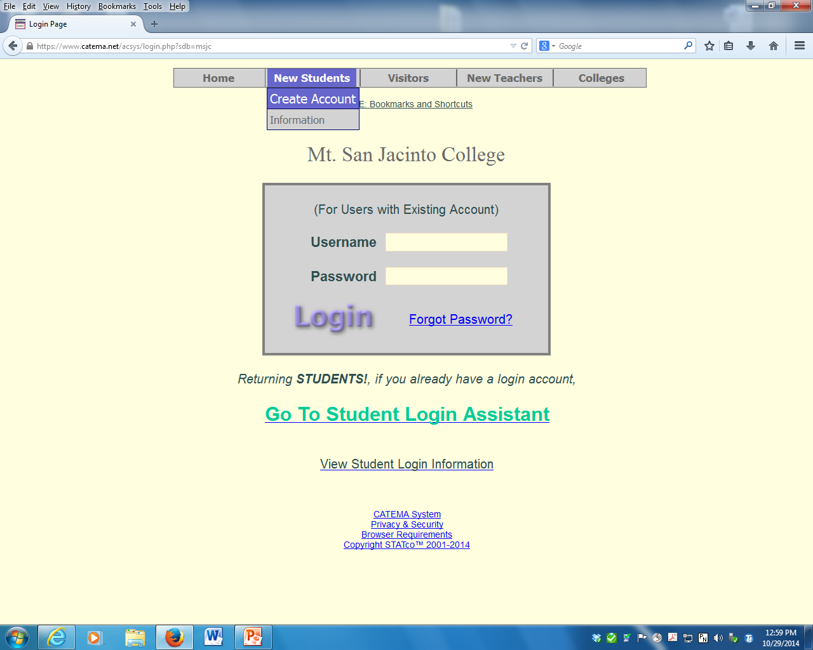
Riverside Community College District
Go to new student.
Then click on create account.

Slide 5
RCCD
RCCD ID only)
No state Id needed

Slide 6
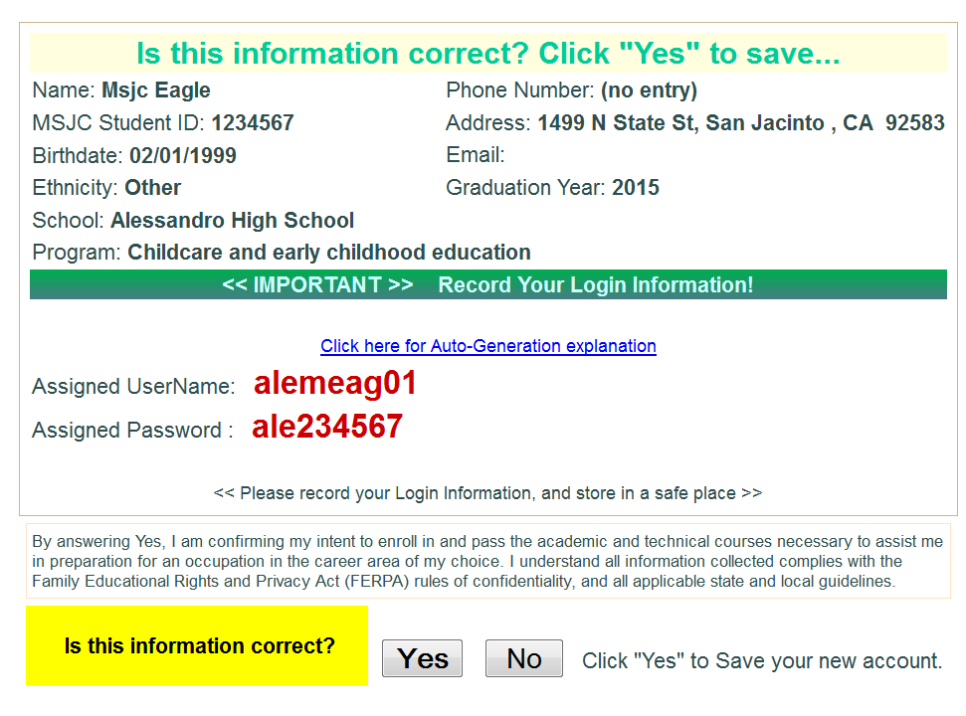
Lori Benson
2001 Third Street, Norco, CA 92860
Lorib@school.com
alelben01
ale234567
Write this down!!!!!!!
Then click “YES”

Slide 7
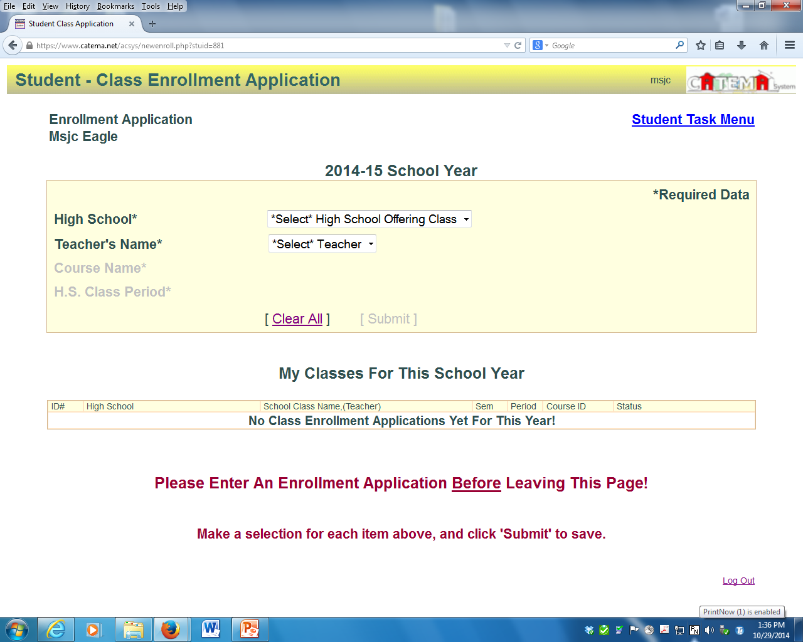
Lori Benson
Select school
Select teacher
Select Course name
Select Period
Click Submit

